Slide 1
E-Exam Project
Prepared For: Amr Abohany

Slide 2
Team Member:
Ahmed Yehia El-Sayed
Mohamed Ahmed Salem
Omnia Belal Mohamed

Slide 3
Scope:
An online examination is the conducting of an examination or test online in order to measure student’s academic performance.
These evaluations were conducted orally or through written tests using pen and paper. Students gathered in an examination hall or room.
With an online examination, the mode of test-taking has changed – instead of a physical examination hall, students instead log into an online examination system through which they access the question paper and share their answers.

Slide 4
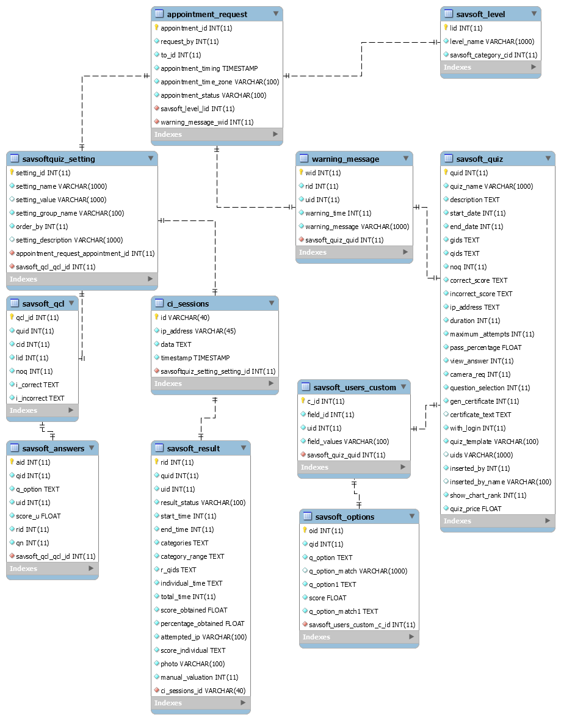
ERD E-EXAM SYSTEM

Slide 5
doctor User Flow

Slide 6
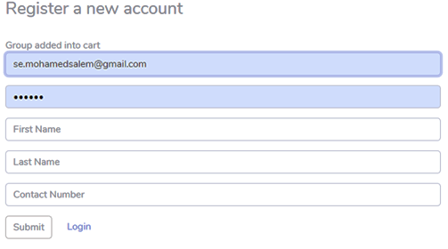
The admin can register both the doctor and the student through the following Screen.
Admin@yahoo.com
**************

Slide 7
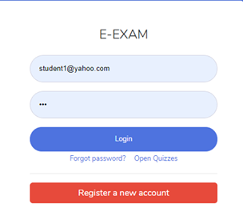
The login screen for both the admin and the doctor

Slide 8
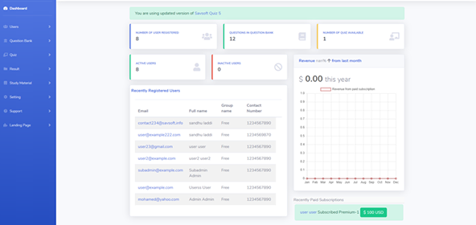
The control panel (Dashboard) contains all the statistics and information that you need to manage the system

Slide 9
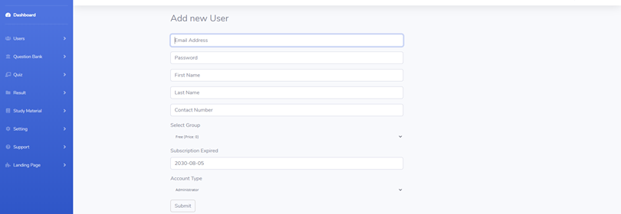
Register a student by the admin or doctor through the following screen

Slide 10
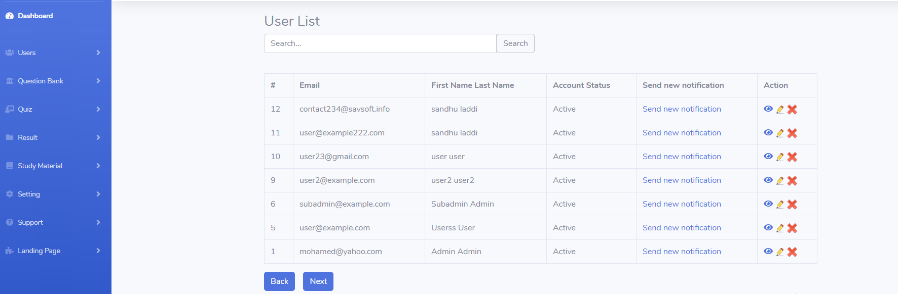
Student management (delete, Update or view) student data or send a notification that the exam is ready

Slide 11
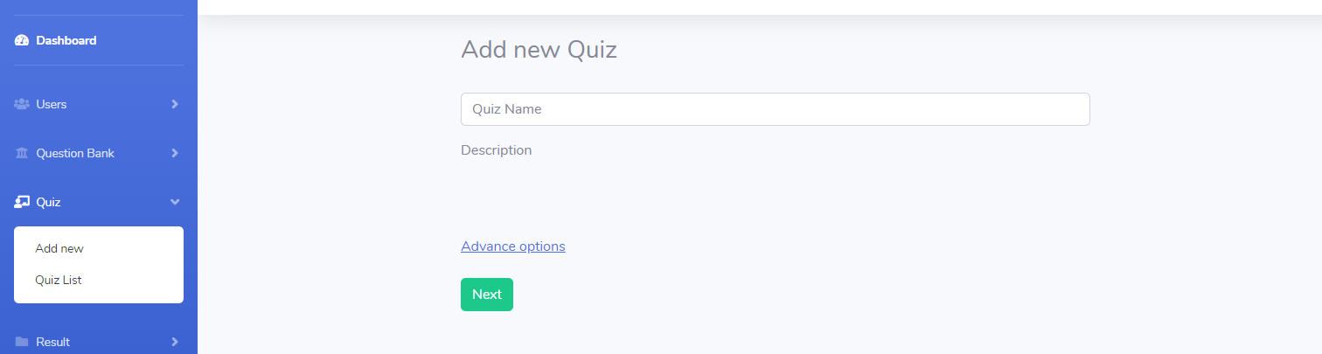
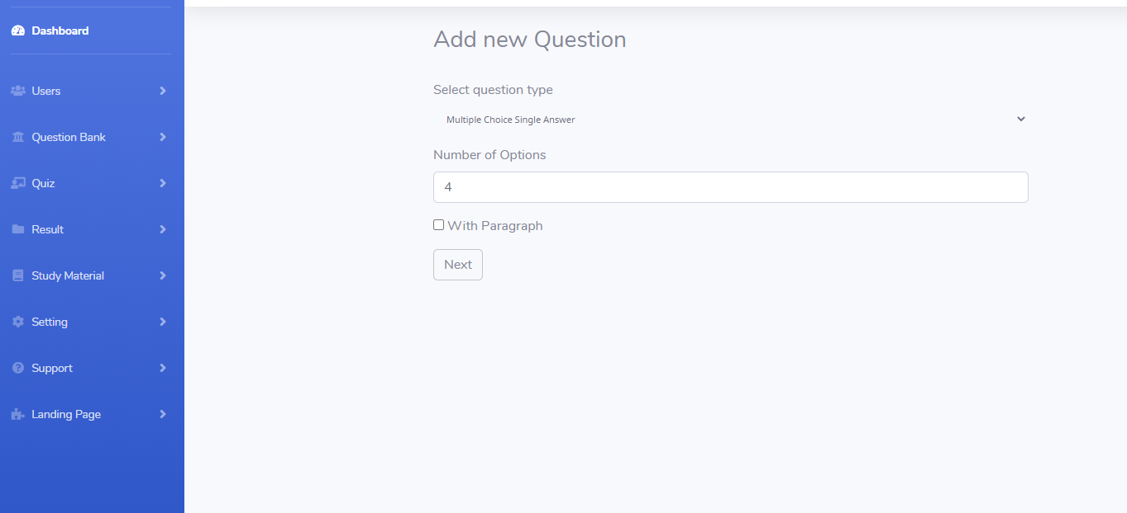
Add a new Quiz via the following screen

Slide 12
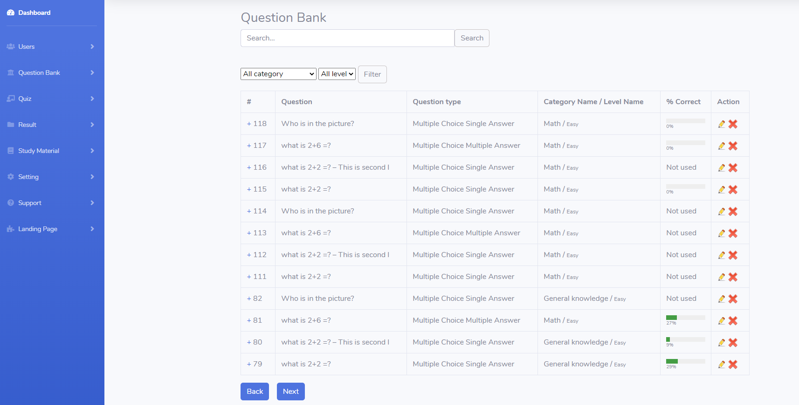
Managing the question bank, assigning questions for each exam, deleting and updating questions

Slide 13
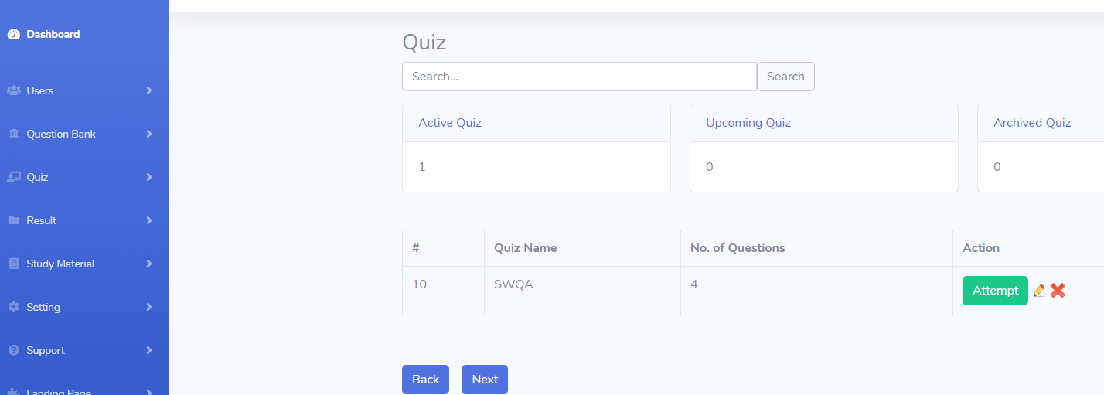
Assigning the students that he must take this exam and attempt to test the quiz.

Slide 14
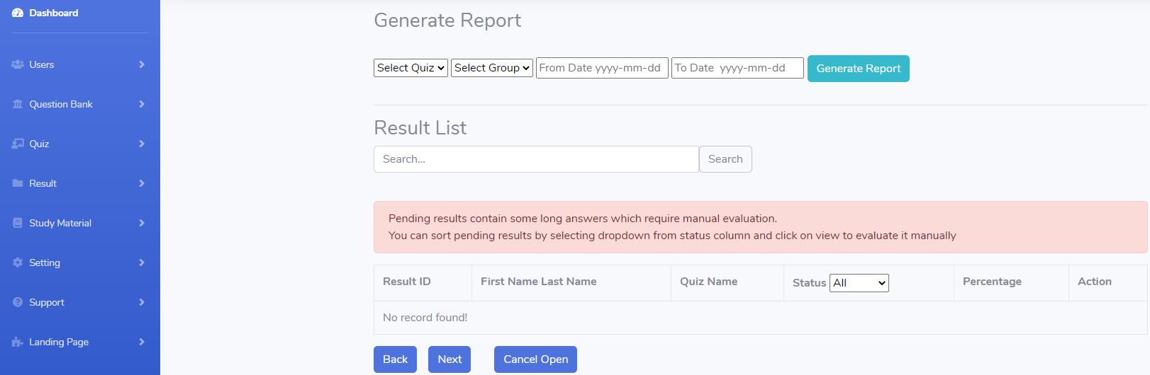
Generate reports for QUIZ.

Slide 15
Student user flow

Slide 16
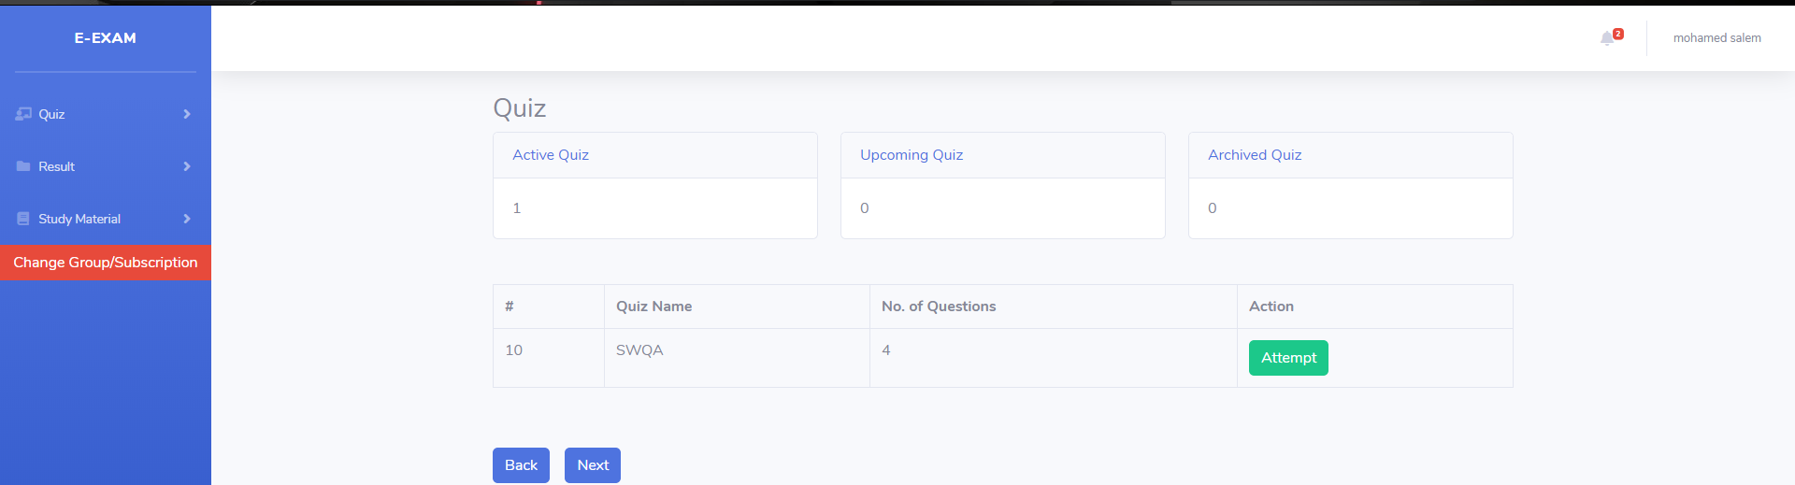
the student chooses the exam that he must pass Such as swqa

Slide 17
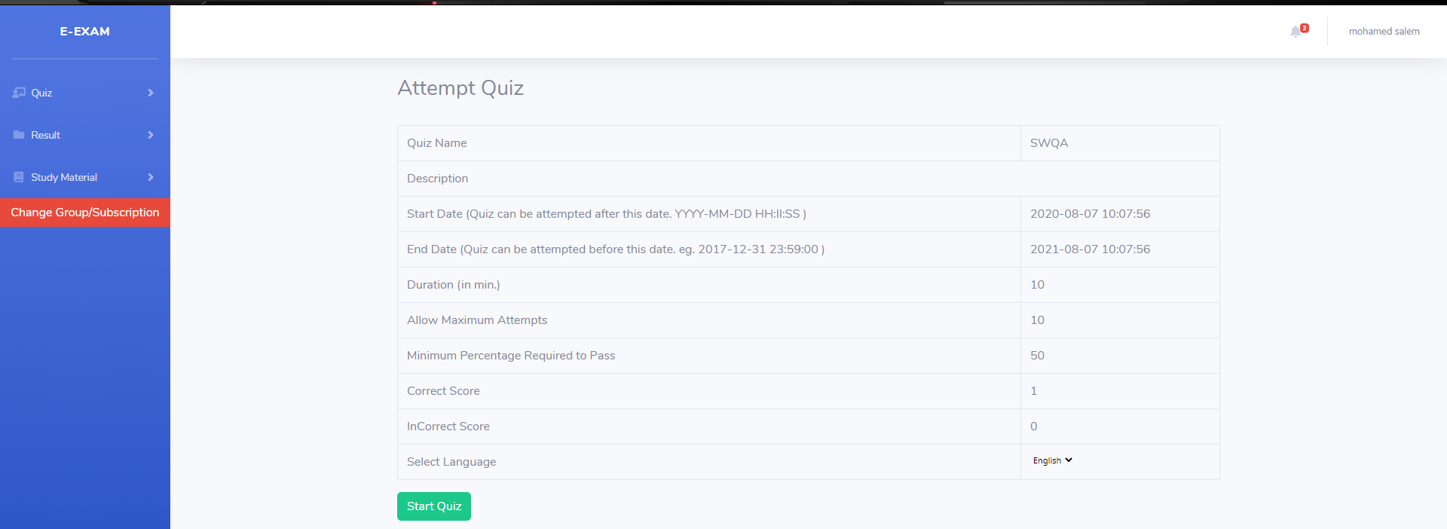
Information about the QUIZ, the start and end date of the project

Slide 18
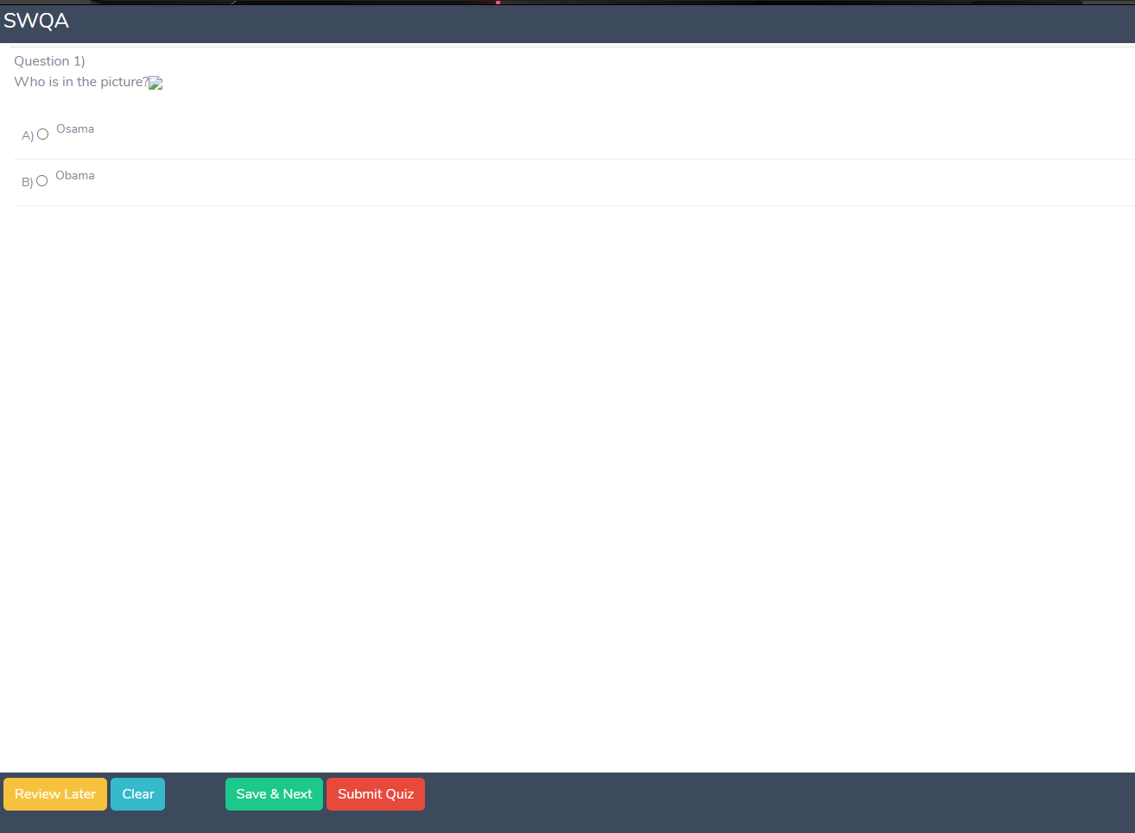
Start solving the exam

Slide 19
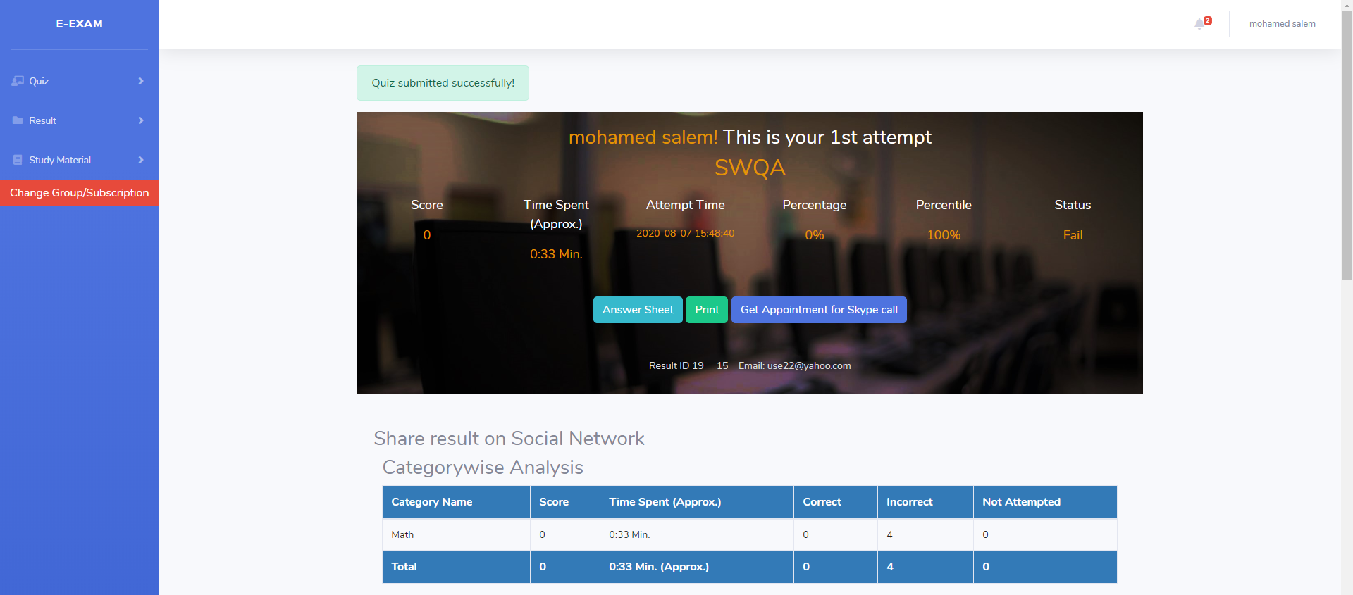
exam degree
Student

Slide 20
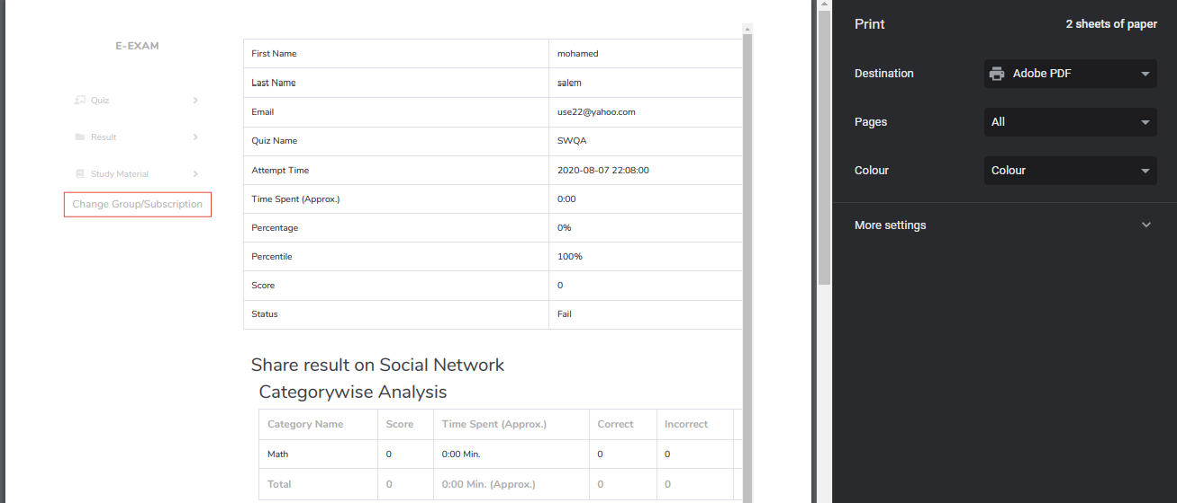
Print result

Slide 21
GitHub Link
https://github.com/SE-MohamedSalem/E.EXAM

